Slide 1

Containerization
Definition
Features
Containerization is a lightweight form of virtualization that packages applications and their dependencies into isolated units called containers, ensuring consistent execution across different environments.
Isolation: Applications run in isolated environments.
Lightweight: Containers share the host OS kernel, using fewer resources than virtual machines.
Portability: Containers can run consistently across different systems.
Scalability: Containers enable rapid scaling of applications.
Dependency Management: Packages application dependencies along with the app.

Slide 2
Containerization
Advantages
Disadvantages
Portability: Run consistently across multiple environments.
Resource Efficiency: Less overhead compared to virtual machines.
Fast Deployment: Quick start times and scalability.
Improved DevOps: Seamless integration with CI/CD pipelines and DevOps practices.
Simplified Dependency Management: No "works on my machine" issues.
Security Risks: Containers share the host OS, leading to potential vulnerabilities.
Limited OS Support: Containers rely on the host OS kernel, limiting the choice of operating systems.
Complexity: Managing many containers can be complex without orchestration tools.

Slide 3
Containerization
Working
Types
Images: Containers are built from images that include the application and its dependencies.
Containers: Run-time instances of images that execute isolated applications.
Host OS: Containers share the host OS kernel but operate in isolated environments using namespaces and cgroups.
Operating System-Level Containers: Share the host OS (e.g., Docker).
Application Containers: Encapsulate only the application, allowing multi-language apps (e.g., LXC).
System Containers: Simulate a full operating system (e.g., LXD).

Slide 4
Containerization
Lifecycle
Tools
Development: Code and dependencies are packaged into container images.
Build: Images are built and stored in a container registry.
Deploy: Containers are deployed to environments.
Run: Containers are executed, isolated from the host.
Scaling: Additional container instances are spun up or down as needed.
Monitoring: Container performance is monitored for optimization.
Termination: Containers are destroyed when no longer needed.
Docker: A platform for building, shipping, and running containers.
Kubernetes: Automates container orchestration and scaling.
Podman: A daemon-less container engine.
Containerd: A runtime that manages container lifecycles.
OpenShift: A Kubernetes distribution with enterprise features.

Slide 5

Why Containerization?
Consistency Across Environments: Eliminates environment-related issues.
Faster Development & Deployment: Speeds up application delivery.
Scalability: Allows dynamic scaling of applications.
Efficiency: Reduces resource overhead and infrastructure costs.
Microservices Architecture: Supports microservices deployment and management.

Slide 6
History of Containerization
1979-2000s: Early concepts of containerization started with Unix chroot and FreeBSD jails.
2000s: Technologies like Solaris Zones and LXC laid the foundation.
2013: Docker revolutionized containerization by making it accessible and easy to use.
2015-Present: Kubernetes emerged as the dominant orchestration tool, and containers became mainstream in cloud environments.

Slide 7
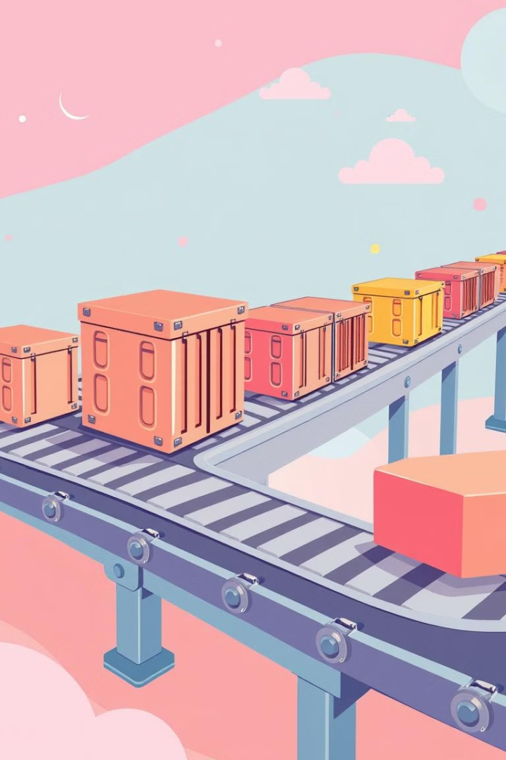



Integrates with CI/CD Pipeline
Containerized Builds/Automated Builds
CI/CD pipelines package applications into containers for consistency across environments. Containers enable automated builds and tests, streamlining the software development process and accelerating deployment.
Automated Testing
Containers are used for running automated tests in isolated environments.
Deployment/Cloud-Native Deployment
Containers are deployed to staging or production environments via CD pipelines.
Faster Delivery
Containerized applications can be deployed quickly and efficiently, reducing time to market and accelerating business outcomes.
Rollbacks
Containers enable easy rollback to previous versions if issues occur.
Scaling
CI/CD can trigger automatic scaling of containers based on demand.

Slide 8
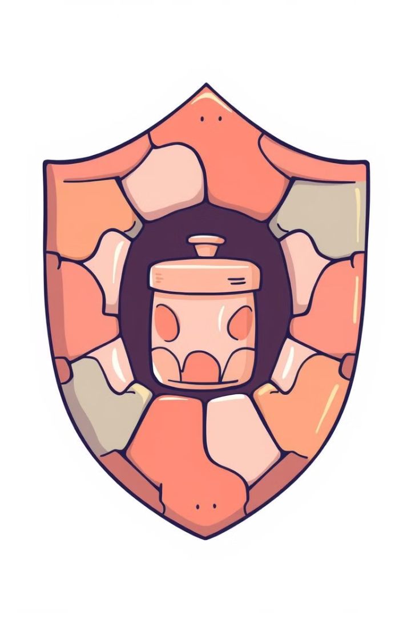
Security Considerations in Container Environments
1
Image Scanning
2
Least Privilege
Regularly scan container images for vulnerabilities and ensure they are up to date with security patches.
Run containers with the minimum necessary permissions, reducing the attack surface and mitigating potential security risks.
3
Network Segmentation
Isolate containers from each other and external networks using network segmentation to prevent unauthorized access and data breaches.

Slide 9
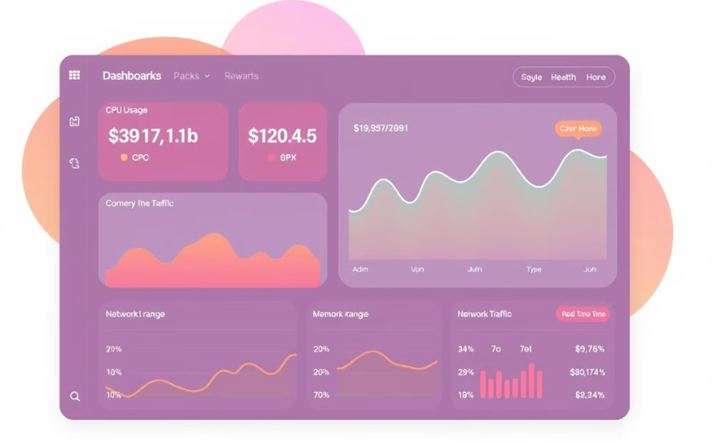
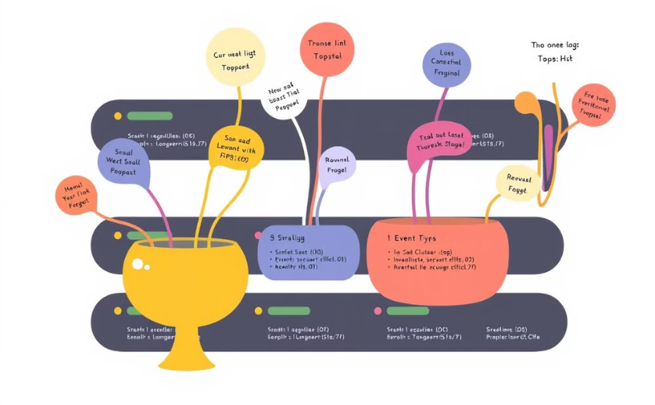
Monitoring and Logging in Containerized Environments
Container Monitoring
Container Logging
Track container health, resource utilization, and performance metrics for proactive troubleshooting and optimization.
Collect and aggregate logs from containers for analysis, debugging, and incident investigation.

Slide 10

Best Practices for Effective Containerization
Use Lightweight Images: Minimize image size by using minimal base images.
Automate Testing: Integrate containers into CI/CD for automated testing.
Implement Security: Regularly scan container images for vulnerabilities.
Use Multi-Stage Builds: Keep build dependencies separate from runtime code.
Orchestrate Containers: Use orchestration tools like Kubernetes for large-scale environments.
Limit Privileges: Run containers with the least privilege necessary.

Slide 11
Docker vs Rkt
Feature | Docker | Rkt (Rocket)
Primary Use Case | Containerization and application deployment | Secure and modular container execution
Container Daemon | Requires a central daemon (Docker Engine) | No central daemon; runs directly as a process
Container Format | Uses Docker image format | Supports App Container Image (ACI) and Docker images
Orchestration Support | Supports Docker Swarm, Kubernetes | Supports Kubernetes, systemd natively
Security Model | Root privileges required (by default) | More security-focused, runs with fewer root privileges
Image Management | Docker Hub for managing images | No native image repository (uses external registries)
Networking | Built-in networking (Docker networks) | Relies on external tools like CNI for networking
Development Focus | Widely adopted for general containerization | Security, modularity, and flexibility for enterprise use
License | Open-source with commercial options | Open-source
Status | Actively developed and widely used | Discontinued in 2020 (CoreOS merged into Red Hat)

Slide 12
Docker vs Kubernetes vs Podman vs Containerd vs OpenShift
Feature | Docker | Kubernetes | Podman | Containerd | OpenShift
Primary Use Case | Containerization platform | Container orchestration | Container management | Container runtime | Kubernetes-based PaaS
Container Orchestration | Limited (Docker Swarm) | Full orchestration (multi-cluster) | No built-in orchestration | No orchestration | Built-in Kubernetes orchestration
Runtime Dependency | Uses Containerd as runtime | Integrates with multiple runtimes | Uses Containerd by default | Standalone container runtime | Uses CRI-O and Kubernetes
Rootless Mode | Requires root privileges | N/A | Supports rootless containers | Requires integration with other tools | Supports rootless containers
Deployment Model | Local development and deployment | Production-grade cluster management | Local and cloud-native | Lightweight runtime for container management | Enterprise-grade platform with CI/CD
CLI Compatibility | Docker CLI | kubectl for cluster management | Docker-compatible CLI | Works with higher-level tools | Web-based and CLI management
Integration | Extensive integrations | Extensive integrations | Podman integrates with Buildah, Skopeo | Integrated into Kubernetes stack | Strong Red Hat ecosystem integrations
Use Case | Single-host containerization | Multi-host, cloud-native orchestration | Rootless container management | Container runtime for Kubernetes | Enterprise-grade application development
License | Open-source, with commercial options | Open-source | Open-source | Open-source | Open-source (with Red Hat support)

